Slide 1
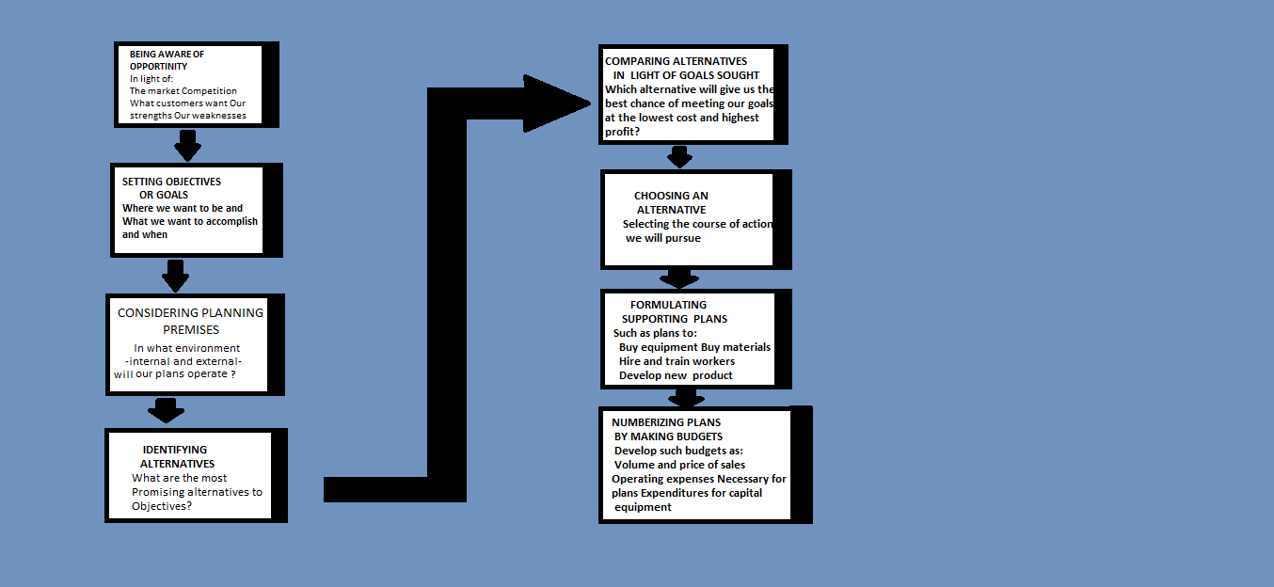
Steps in planning process

Slide 2
MANAGEMENT BY OBJECTIVES-MBO
Is a comprehensive managerial system that integrates many key managerial activities in a systematic manner.
MBO is consciously directed towards the effective and efficient achievement of organizational and individual objectives.
Peter F. Drucker In 1954 acted as a catalyst by emphasizing that objectives must be set in all areas.
Laid down a philosophy that emphasizes self control and self direction.

Slide 3
OBJECTIVES
Objectives state end results, and overall objectives need to be supported by sub objectives .
Hierarchy of objectives: two dimensions
The purpose of society: is to contribute to the welfare of the people by providing goods and services at a reasonable cost.
Purpose of the business: to furnish convenient low- cost transportation for the average person.
Example: Mission-- to produce, market and service automobiles.

Slide 4
8 key result AREAS identified by peter drucker FOR SETTING OBJECTIVES
1. Market standing(market share)
2. Innovation
3. Productivity
4. Physical and financial resources
5. Profitability
6. Managerial performance and development
7. Worker performance and attitude
8. Public responsibility

Slide 6
types of objectives
Verifiable Objectives
Examples:
1. To achieve a return on investment of 12%
at the end of the current fiscal year.
2. To issue a two-page monthly newsletter
beginning July 1,2013, involving not more
than 40 working hours of preparation time
(after the first issue).
3. To increase production output by 5% by
December 31, 2013, without additional
costs and while maintaining the current
quality level.

Slide 7
continued
4. To design and conduct a 40-hour in-house program on the “fundamentals of management, "to be completed by October 1, for management development staff and with at least 90% of the 100 managers passing the exam.
5.To install a computerized control system in the production department by December 31, requiring not more than 500 working hours of systems analysis and operating with not more than 10% downtime during the first 3 months.

Slide 8
2. Non verifiable Objectives
Examples:
1. To make a reasonable profit
2. To improve communication
3. To improve productivity of the production
department.
4. To develop better managers
5. To install a computer system

Slide 9
RELATIONSHIP OF OBJECTIVES AND THE ORGANIZATIONAL HIERARCHY
1. Socio-economic purpose
2. Mission
3. Overall objectives of the organization (long-range, strategic)
4. More specific overall objectives
5. Division objectives
6. Department and unit objectives
7. Individual objectives
- Performance
- Personal development objectives
Board of Directors
Top level managers
Middle level managers
Lower level managers
(Some)
(Some)
HIERARCHY OF OBECTIVES
ORGANIZATION HIERARCHY

Slide 10
EXAMPLE
Examples: objectives which can be set for key result areas are:
Obtain 10 percent return on investment by the end of calendar year 2O13 (profitability).
To increase the number of units of product X by 7 percent without an increase in cost or productivity.
Top managers are involved in determining the purpose, the mission and the overall objectives of the firm,
Middle-level managers, vice- president production manager are involved in setting key- result area objectives, division objectives, and department objectives.
Lower level managers is setting objectives of department and units as well as of their subordinates.

Slide 11
Network of programs for new product program
Product
Research program
Production engineering
program
Manufac-
Turing
program
Program for distribution
And warehousing
Approved
Product
idea
Package
Design
program
Sales program
Advertising
And promotional program
Program for
Implmen-
tation of
advertising
Product
commercia
-lization
Market
Research program
Program for recruitment of sales people
Sales training
program
Launch of
Sales program

Slide 12
OVERALL OBJECTIVES OF A UNIVERSITY
Attracting highly qualified students
Offering basic training in the liberal arts and sciences as well as in certain professional fields.
Granting the Ph.D degree to qualified candidates
Attracting a highly regarded faculty
Discovering and organizing new knowledge through research.
Operating as a private school supported principally through tuition and gifts of alumni and friends.

Slide 13
APPROACHES TO SETTING OBJECTIVES
In top- down approach upper- level mangers determine the objectives for subordinates.
In the bottom- up approach subordinates initiate the setting of objectives for their positions and present them to their superior.
Top- down approach suggest that the total organization needs direction through cooperate objectives provided by the chief executive officer.
The bottom-up approach, argue that top management needs to have information from lower levels in the formation of objectives.
Subordinates are likely to be highly motivated by and committed to goals which they initiate.

Slide 14
Emphasis on performance Appraisal
In 1957 , Douglas McGregor suggested a new approach to appraisal based on Peter Drucker’s concept of management by objectives.
Subordinates assume the responsibility of setting short-term objectives for themselves, and then they review those objectives with their superior.
Performance is then evaluated against the present objectives.
General Electric Company was using elements of MBO in its reorganization efforts to decentralize managerial decision making.

Slide 15
The systems Approach to MBO
Managerial subsystems that can be integrated into the MBO process include:
Design of organizational structures, Portfolio management.
Management development, career development, compensation programs and budgeting.
Most key managerial activities can and should be integrated with the MBO process.
Highest degree of integration of MBO with managerial functions was in controlling planning and directing.

Slide 16
THE PROCESS OF m bo
Process starts at the top of an organization and has the active support of the chief executive.
It can start at the division level or at the marketing manager level or even lower.
One of the critical needs in MBO is the development and dissemination of consistent planning premises.

Slide 17
Setting Preliminary Objectives at the top
Determine what he perceives to be the purpose or mission and important goals of the enterprise.
Set for any period a quarter, a year, 5 years or whatever is appropriate in given circumstances.
The goals set by the superior are based on an analysis and judgment as to what should be accomplished within a certain period.
Goals must be regarded as tentative and subject to modification.
Manager also establishes measures of accomplishment.

Slide 18
ENTERPRISE OBJECTIVES
Key Result Areas
PLANNING PREMISES
Appropriate organization
Superior’s objectives
Superior’s preliminary recommendation of objectives for subordinate
Subordinate’s preliminary statement of objectives
Available needed resources
Subordinate objectives
Subordinate’s ongoing performance
Periodic review of progress by superior
Corrective measures and superior’s assistance
Final performance by subordinate
FINAL REVIEW AND APPRAISAL OF PERFORMANCE
NEW INPUTS

Slide 19
SETTING SUBORDINATES’ OBJECTIVES
Superior asks: what goals the subordinates believe they can accomplish, in what time period? and with what resources?.
Questions include:
What can you contribute, how can we improve your operation to help me improve mine?
what stand in the way, what obstructions keep you from a higher level of performance what changes can we make?
Superiors must also be patient counselors helping their subordinates and being careful not to set goals that are impossible to achieve.
Set what is consistent with goals of other managers in other functions.

Slide 20
SETTING OBJECTIVES-continued
Superior has to work with the subordinates in setting their objectives.
What are the problems for achieving a higher level of performance?
Superiors must listen to ,and work with ,but in the end they must take responsibility for approving subordinates goals.
Final approval must be based upon what is reasonably attainable.

Slide 21
RECYCLING OBJECTIVES
Objectives must be set starting either at the top or at the bottom level.
A degree of recycling is required for it’s successful accomplishment.
Setting objectives is not only a joint process but also an interactive one.

Slide 22
BENEFITS OF MBO
1.Improvement of managing
Results in greatly improved management.
Forces managers to think about planning for results.
A clear set of goals and standards ensures better control
2. Clarification of organization.
Forces managers to clarify organizational roles and structures.
3. Encouragement of personal commitment .
It encourages people to commit themselves to their goals.
People become enthusiastic when they control their own fate.
4. Development of effective controls.
It aids in developing effective controls

Slide 23
LIMITATIONS OF MBO
1. Failure to teach the philosophy of MBO
Philosophy is built on the concept of self control and self direction
2. Failure to give guidelines to goal setters
If corporation goals are vague,unreal,or inconsistent, it is virtually impossible for managers to tune in with them.
3. Difficulty of setting goals
Truly verifiable goals are difficult to set .
Top mgt. must agree to reasonable objectives and clearly state
4. Behavioral expectations

Slide 24
continued
5. Emphasis on short- run goals: Superiors must assure themselves that current objectives are designed to serve longer range goals.
6. Danger of inflexibility: Managers often hesitate to change objectives even though it has become obsolete by revised corporate objectives, changed premises, modified policies.
7.Other dangers: People may overuse quantitative goals and attempt to use numbers everywhere and they may downgrade important goals.
Danger of forgetting that managing involves more than goal setting .
Difficulty of applying goal oriented planning in a very dynamic and complex environment.

